Slide 1
CH22 IPSec and TLS
ZJU 2021
Notes:
This chapter provides an overview of computer security. We begin with a discussion
of what we mean by computer security. In essence, computer security deals
with computer-related assets that are subject to a variety of threats and for which
various measures are taken to protect those assets. Accordingly, the next section of
this chapter provides a brief overview of the categories of computer-related assets sds
that users and system managers wish to preserve and protect, and a look at thed
various threats and attacks that can be made on those assets. Then, we survey the
measures that can be taken to deal with such threats and attacks. This we do from
three different viewpoints, in Sections 1.3 through 1.5. We then lay out in general
terms a computer security strategy.
The focus of this chapter, and indeed this book, is on three fundamental
questions:
1. What assets do we need to protect?
2. How are those assets threatened?
3. What can we do to counter those threats?

Slide 2
Outline
IPSec
Tunnel mode, transport mode
ESP and AH for confidentiality and authenticity
Transport Layer Security (TLS)
Record protocol
Handshake protocol
Notes:
IPSec can operate in tunnel or transport mode
Confidentiality and authenticity protection provided through ESP and AH
The one-way security association stores security parameters.
SSL/TLS has two layers:
record protocol
handshake, change cipher spec and alert protocols

Slide 3
IP Spoofing
IP spoofing is a common technique in cyber attacks, e.g., DNS Amplification DoS Attack:
Bots spoof IP address of a target system
Then send DNS queries to DNS servers
The DNS servers respond, sending large amounts of data to the target system
Notes:
A critical weakness of IPv4 is that there is no authentication of the source IP address. That is, if Alice receives a packet with Bob’s source IP address, Alice can not be sure that the packet is really from Bob. In practice, IP spoofing is a common technique used in cyber attacks. For example, bots in a botnet can send a DNS query to DNS servers asking the full TXT record of a domain, by spoofing the source IP address of a victim web site. As a result, the response from the DNS servers, which can amount to a very large volume of data, is sent to the victim web site, resulting in a denial-of-service at the site.

Slide 4
Goals of IPSec
Verify sources of IP packets
Provide Authentication that is lacking in IPv4
Protect integrity and/or confidentiality of packets
Prevent replaying of old packets
Provide security for upper layer protocols and applications
Notes:
IPSec provides security measures at the IP layers, including authentication of source IP addresses, confidentiality and integrity protection of packet data, and authenticity of packet data (preventing replay).
Of course, a network application or protocol can implement its own specific security mechanisms to achieve these goals. By implementing security at the IP level, we can ensure secure networking not only for applications that have security mechanisms but also for the many security-ignorant applications because they all run on top the IP layer.

Slide 5
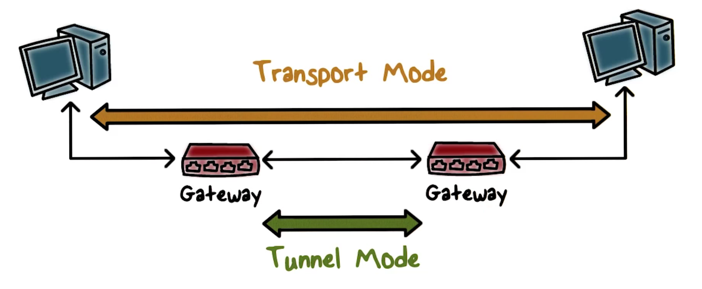
Two Modes of IPSec
IPSec has 2 modes:
Transport mode: only the payload of the IP packet is encrypted or authenticated, not the header. Security protection is provided to traffic from one end host to another, i.e., end-to-end.
Tunnel mode (for VPN): the entire IP packet (header+payload) is encrypted and authenticated. It is then encapsulated into a new IP packet with a new IP header. Security protection is provided to traffic from gateway of a network to the gateway of another network. (Gateway is often also the firewall)
Notes:
IPSec (tunnel mode) should be implemented within the gateway or firewall
This is how VPN (Virtual Private Network), is implemented.

Slide 6
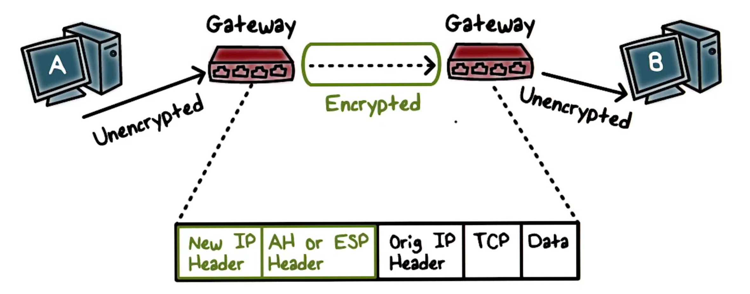
Tunnel Mode
Suppose we have two end hosts, A and B, belonging to the same company but in two different Local Area Networks (LAN) over the Internet (e.g., two campuses of a university).
Before A’s packets leave its LAN, the gateway encrypts them and sends encrypted packets to the gateway to B’s LAN, which then decrypts the packets. An encrypted packet contains:
New IP header that specifies the gateway as the source IP and B's gateway as its destination IP.
IPSec header that contains information about the protection provided using AH or ESP
The original packet as the data or payload.

Slide 7
IPSec Quiz
IPsec can assure that
A. a router advertisement comes from an authorized router
B. a routing update is not forged
C. a redirect message comes from the router to which the initial packet was sent
D. all of the above
ANS: D

Slide 8
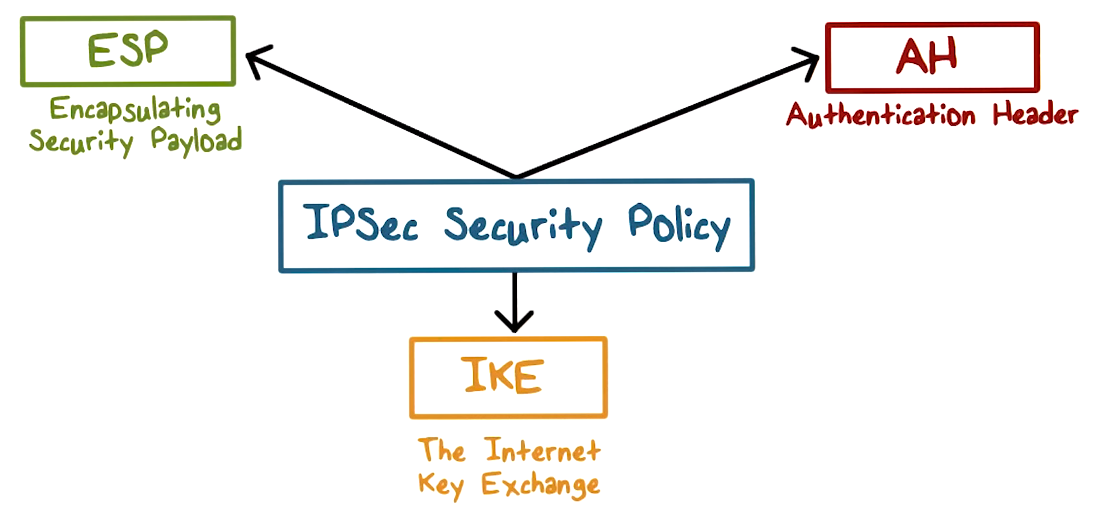
IPSec Architecture
IPSec includes
Internet Key Exchange (IKE) protocol for negotiating protection parameters, including cryptographic algorithms and keys
Two types of protections: ESP and AH.

Slide 9

Encapsulated Security Payload (ESP)
Encrypt and authenticate each packet
Encryption is applied to packet payload
Authentication is applied to data in the IPSec header as well as the data contained as payload, after encryption is applied
Notes:
ESP stands for encapsulated security payload.
When ESP is applied, the packet data portion, or, the payload, is encrypted for confidentiality protection. In addition, as an option, message authentication is applied to the encrypted payload and the IPSec header.

Slide 10
ESP Modes Quiz
ESP can be securely used in...
A. encryption only mode
B. authentication only mode
C. encryption and authentication mode
ANS: A,B,C (but only C is fully secure.)

Slide 11
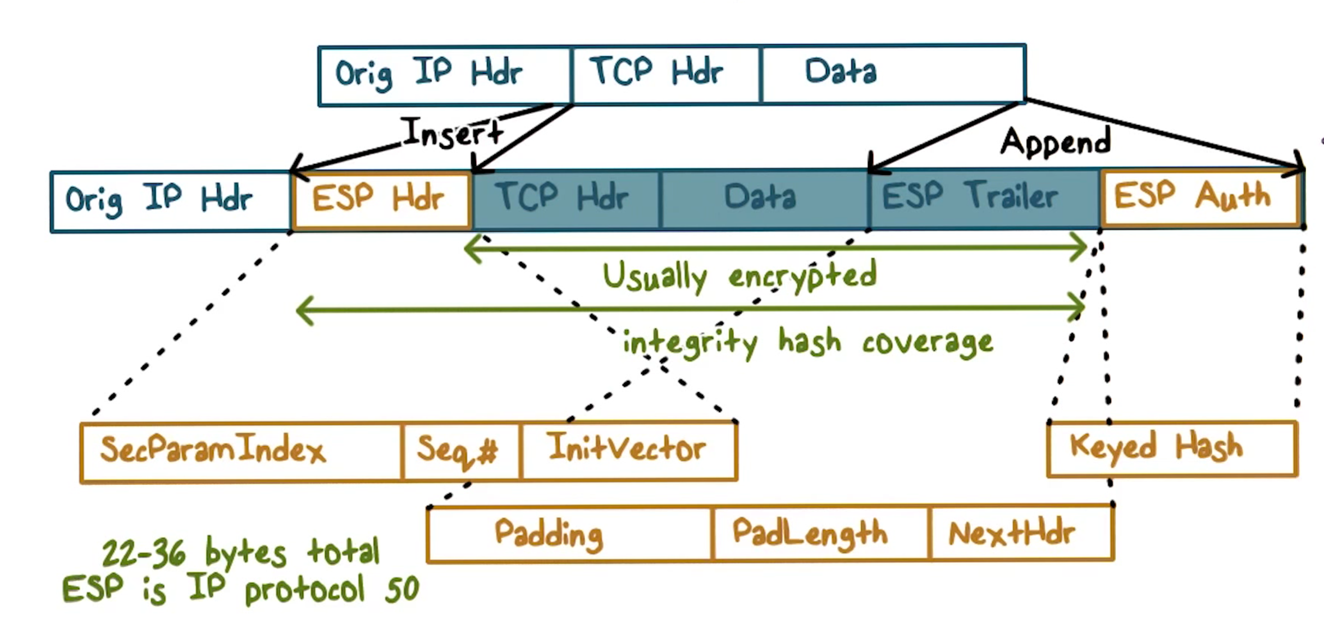
ESP in Transport Mode
ESP header is inserted after the original IP header. It includes the security parameter index, a sequence number, the InitVector (IV) for encryption.
ESP trailer had the padding information and pointer to next header, such as the TCP or UDP header.
Packet payload and the ESP trailer are both encrypted but the ESP header is not because it provides information (e.g., the security parameter index) that tells the receiving end how to decrypt the payload, for example, which algorithm and shared secret key to use.
The ESP header and the encrypted payload are then hashed together with a secret key, and the hash value is stored in ESP Auth as the Message Authentication Code (MAC) for the receiver to verify the authenticity and integrity of the message.
Notes:
This shows the new packet layout when IPSec operates in transport mode and uses ESP.
An IPSec header, in this case, the ESP header, is inserted after the original IP header. It includes the security parameter index, a sequence number, and we will discuss these shortly. The ESP header also includes the IV for encryption. The ESP trailer had the padding information and pointer to next header, such as the TCP or UDP header. The packet payload and the ESP trailer are both encrypted but the ESP header is not because it provides information, in particular, the security parameter index, that tells the receiving end how to decrypt the payload, for example, which algorithm and shared secret key to use.
The ESP header and the encrypted payload are then hashed together with a secret key, and the hash value is stored in ESP Auth as the message authentication code for the receiver to verify the authenticity and integrity of the message.

Slide 12
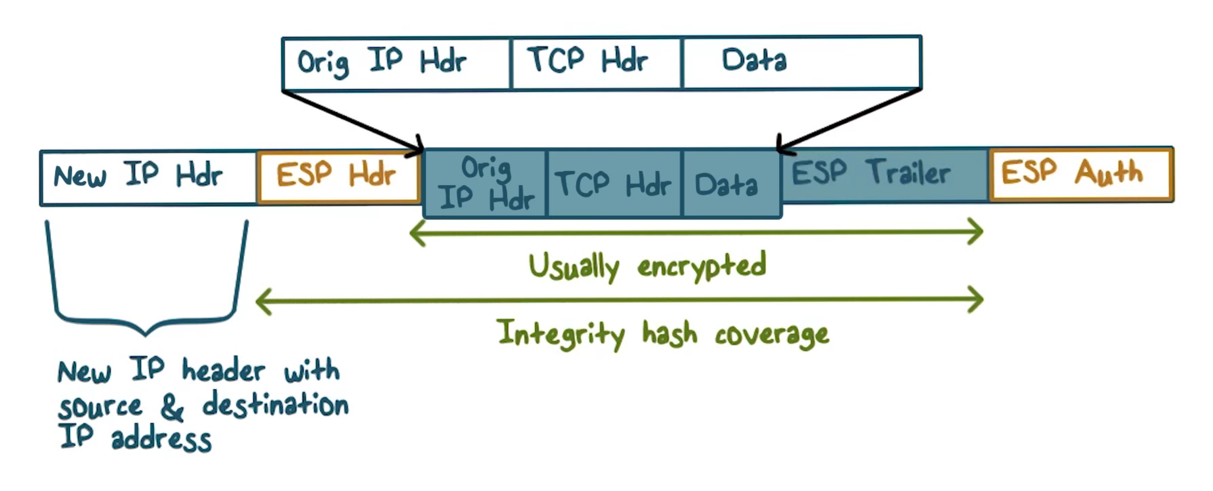
ESP Tunnel Mode
ESP header is added after the new IP header.
Packet payload, which contains the entire original packet plus the ESP trailer, is encrypted.
The original IP header data, including the original source and destination IP addresses are encrypted.
MAC is computed over the entire original packet plus the ESP header and trailer, therefore, header of the original IP, for example, the original IP source address, is authenticated.
Notes:
If tunnel mode is used, then the ESP header is added after to new IP header, and the packet payload, which now contains the entire original packet plus the ESP trailer, is encrypted. Therefore, even the original IP header data, including the original source and destination IP addresses are encrypted. Similarly, the message authentication code is computed over the entire original packet plus the ESP header and trailer, therefore, even the header of the original IP, for example, the original IP source address, is authenticated.

Slide 13
Authentication Header (AH)
In ESP, the IP header is not authenticated. So what if we want to authenticate the entire packet? We can use Authentication Header (AH).
Authentication is applied to the entire packet
Certain fields in the IP header, e.g., time-to-live, or, TTL, that may change in transmission are not included, or, zeroed out, when MAC is computed.
If both ESP and AH are applied to a packet, AH follows ESP
Use ESP to encrypt the payload and then apply AH to authenticate the entire packet.
Notes:
AH does not encrypt anything. But we can use ESP to encrypt the payload and then apply AH to authenticate the entire packet.

Slide 14
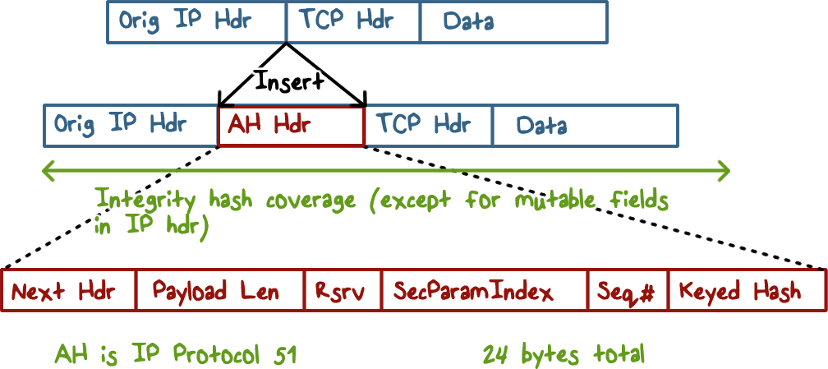
Authentication Header in Transport Mode
If AH is used with transport mode, the AH header is inserted after the original IP header, and contains the authentication code.
Notes:
Other important IPSec information in the AH header includes the security parameter index and the sequence number, and again, we will discuss these shortly.

Slide 15
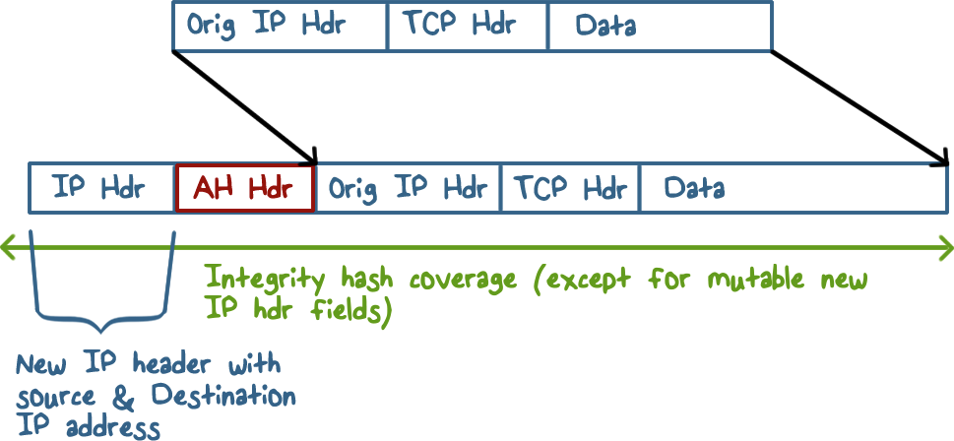
Authentication Header in Tunnel Mode
If AH is used with tunnel mode, the AH header is inserted after the new IP header.

Slide 16
ESP and AH Quiz
Which are true:
A. ESP can provide both confidentiality and integrity protection
B. If the authentication option of ESP is chosen, message integrity code is computed before encryption
C. To protect the confidentiality and integrity of the whole original IP packet, we can use ESP with authentication option in tunnel mode.
D. In AH, the integrity hash covers the IP header
ANS: A,C,D
B is false. If the authentication option of ESP is chosen, message integrity code is computed after encryption.
Notes:
QUIZ:
Discuss
---
SOLUTION:
Discuss 1. T. 2. F. 3. T. 4. T

Slide 17
Internet Key Exchange (IKE)
IKE is the security protocol for two end-hosts or two gateways using IPSec for secure connections. It allows the two parties to:
Exchange and negotiate security policies.
Establish security parameters, or security associations
e.g., ESP or AH, and which cryptographic algorithms for encryption or hashing.
Key exchange
Establish shared keys between two parties.
Notes:
We have discussed that for two parties to communicate securely, they typically need to use a security protocol that performs mutual authentication and key exchange.
For two end-hosts or two gateways to use IPSec for secure connections over the Internet, the security protocol is the Internet Key Exchange, or, IKE, protocol.
This protocol allows the two parties to decide the security policies for the traffic between them, and agree on a set of security parameters, e.g., AH, or ESP, and which cryptographic algorithms for encryption or hashing.
The protocol also

Slide 18
Security Association (SA)
An SA describes security parameters for a type of traffic, e.g., all http connections from host A to B.
One-way relationship between a sender and a receiver, defined by IPSec parameters
One SA for inbound traffic, another SA for outbound
Security Association Database (SADB)
Security Parameter Index (SPI)
A unique index for each entry in the SADB
Receiver identifies the SA associated with a packet by table lookup, in order to unprocess (decrypt) it
Security Policy Database (SPD)
Stores policies used to establish SAs
Notes:
The security parameters for a type of traffic, e.g., all http connections from host A to B, are described in a Security Association.
It is asymmetric. For example, for a TCP connection between A and B, we need one SA for traffic from A to B, and another SA for traffic from B to A.
A host will need many SAs, and it uses an SA database to store them, so each SA has a unique index, And this is the security parameter index, or SPI. It is included in an outgoing packet, so that the receiver can use it to look up the SA to unprocess, e.g., decrypt the packet. For example, when A & B agree on the security parameters, both side will store the same SA to describe these parameters, and the unique index for B’s copy of SA is sent to A so that A can store this SPI in its SA. Then when A processes the packet, it uses the parameters defined in this SA and also includes this SPI.
The security parameters define the security mechanisms, and they are determined by security policies, which are stored in a policy database.

Slide 19
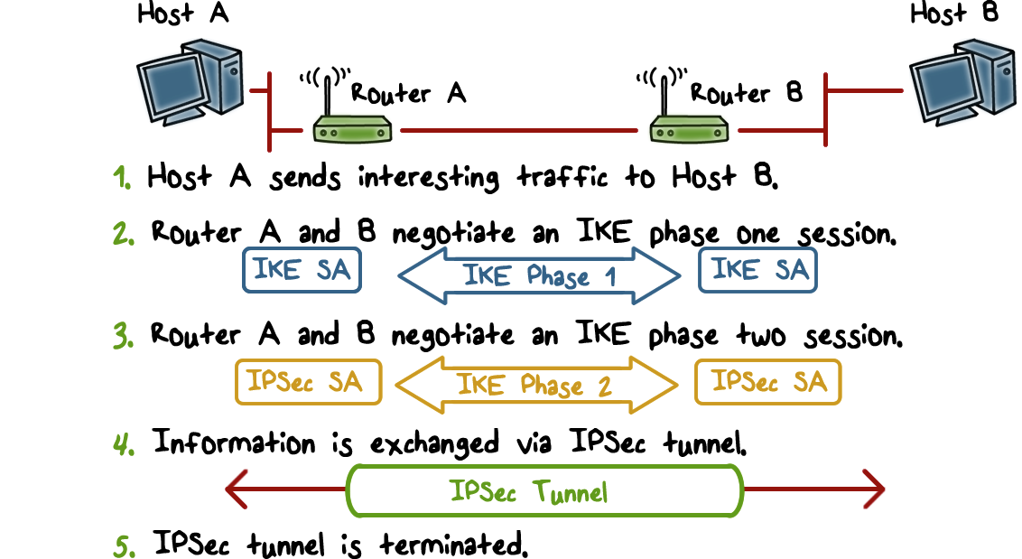
IPSec Summary
(Details of IKE is omitted.)
Notes:
To summarize, if host A and host B wants to securely communicate, here is the typical workflow:
Assuming that this is the first time that A sends data to B that according to policy requires protection, the router or gateway of A’s network and the router of B’s network use the IKE protocol to first negotiate the IKE SA, then use the IKE SA to negotiate the IPSec SAs.
Then an IPSec tunnel can be created between the routers and the traffic between A to B is protected by the tunnel, e.g., the packet data can be encrypted, and optionally, the header information including the source IP address as well as the packet data can be authenticated.
When A terminates the connection to B, the IPSect tunnel between the two routers also terminates.

Slide 20
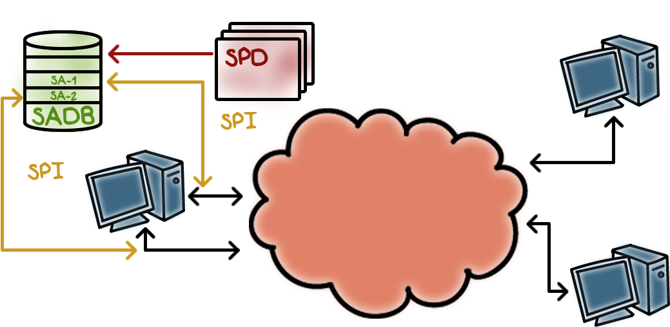
SPD and SADB Fit Together
An SPD entry describes the security policy, which decides the security parameters stored in an SA in SADB.
Each SA has a unique index SPI, which is included in the IPSec packet header.
Notes:
(like a table key)

Slide 21
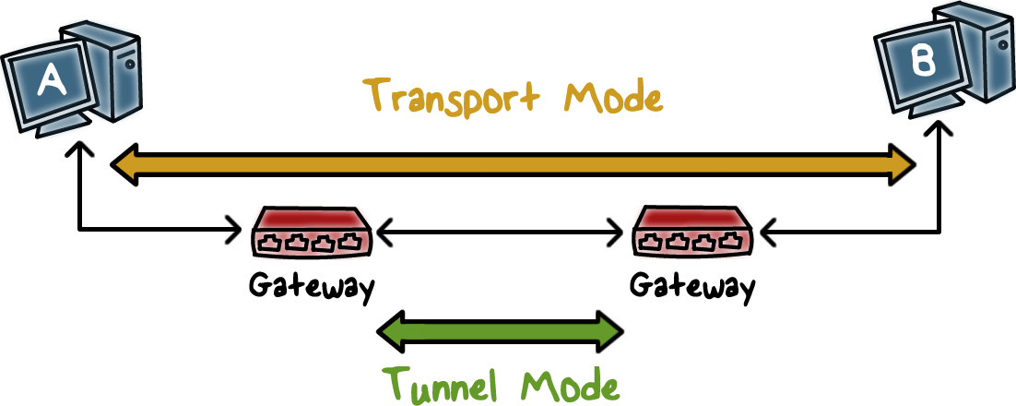
SPD and SADB Example:
Computers A and B wish to communicate with each other.
Notes:
Let’s discuss an example of SPD and SADB:
Recall the tunnel and transport modes…

Slide 22
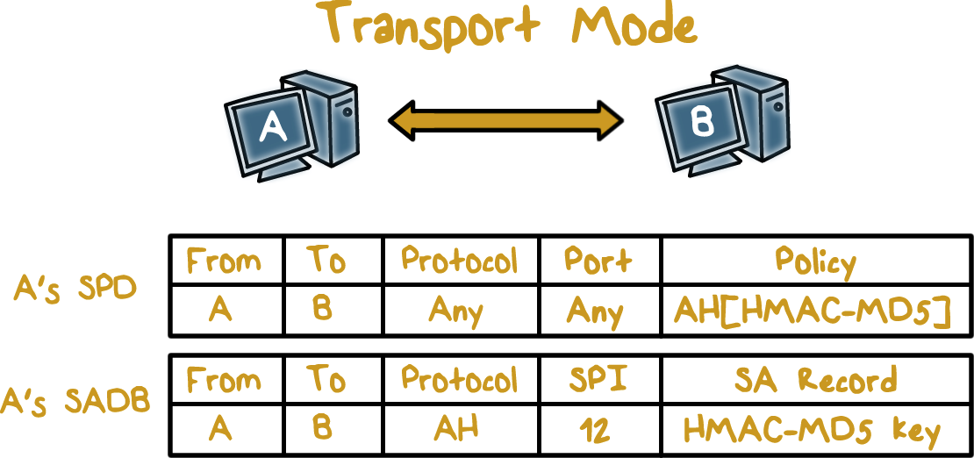
SPD and SADB for Transport mode
A’s SPD entry specifies:
Traffic from A to B for any (protocol, port) combination needs to be authenticated with AH, using HMAC with MD5 as the embedded hash function.
The negotiated parameters are stored in an SA in both A’s and B’s SADB.
A’s SADB stores:
the secret key for HMAC
SPI for looking for the SA in B’s SADB. When A sends out traffic to B, it includes this SPI in the IPSec header so that B can use it to look up the SA and unprocess the traffic.
Notes:
http://www.tcpipguide.com/free/t_IPSecSecurityAssociationsandtheSecurityAssociation.htm

Slide 23
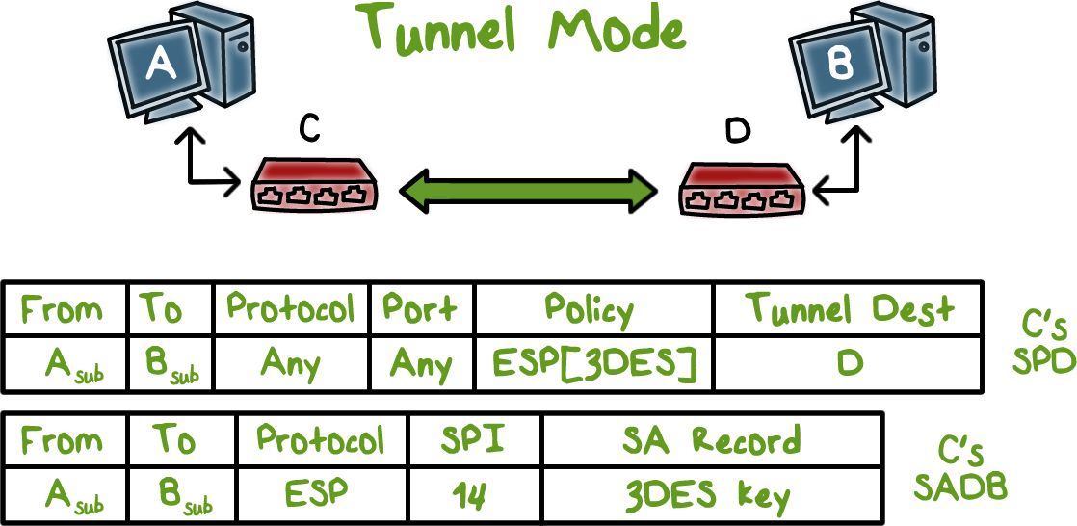
SPD and SADB for Tunnel Mode:
SPD entry of gateway C for A’s subnet specifies:
Traffic from A’s subnet to B’s subnet has tunnel destination D, gateway of B’s subnet, and it should use ESP with 3DES.
C’s SADB stores:
The SA that has the 3DES key, and the SPI for looking up the SA in D’s SADB.
Notes:
Since C is the gateway of the subnet that A belongs to, C’s SPD stores this policy,

Slide 24
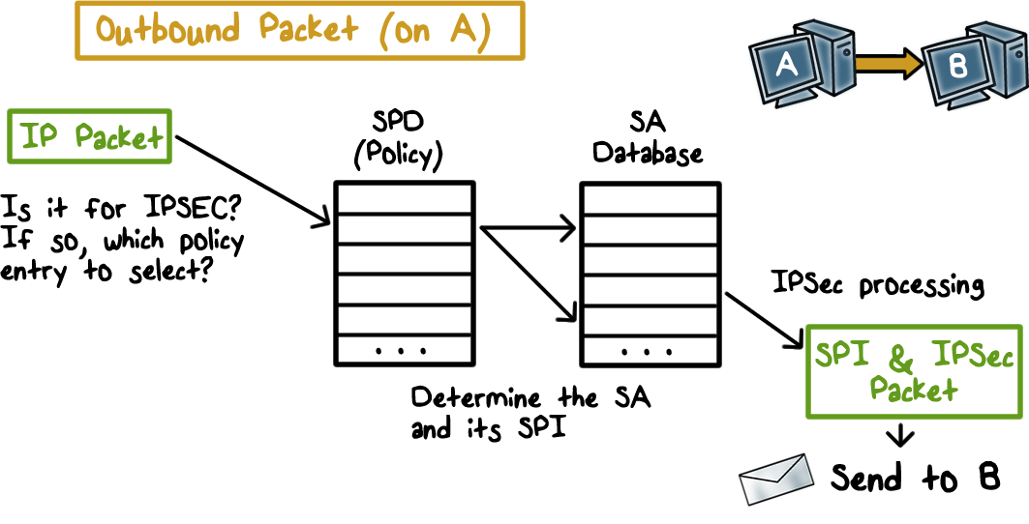
Outbound Processing
When A sends an outbound packet:
First the SPD is looked up to see if traffic, e.g., http traffic from A to B, needs to be protected with IPSec.
If there is a SPD entry, then the SA is looked up in the SADB
Packet is processed accordingly, and the SPI is inserted in the IPSec header.
Notes:
Here is a figure showing the processing of outbound traffic:

Slide 25
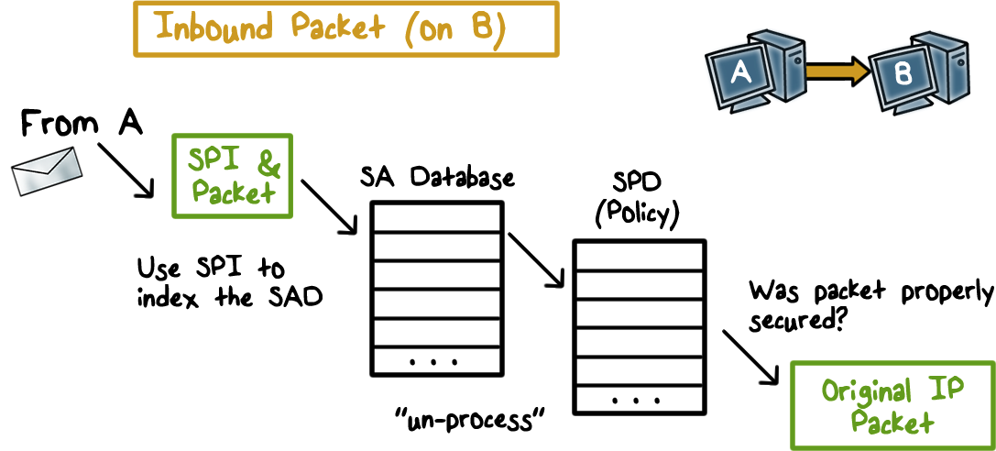
Inbound Processing
When B receives an inbound packet:
The SPI in the IPSec header is used to look up the SA in the SADB, and the packet is unprocessed accordingly.
Then the SPD is looked up to make sure that the packet had the proper security measures according to the policy.
If yet, the packet is delivered to the upper layer.

Slide 26

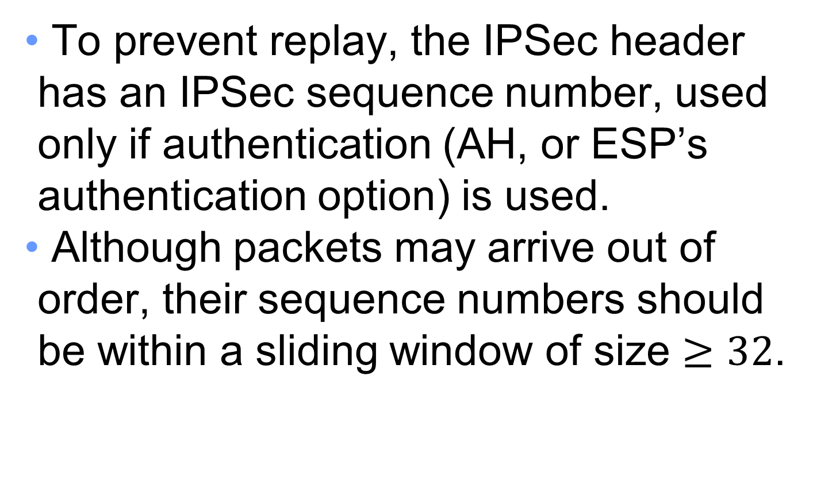
Anti-Replay w. Sliding Window
To prevent replay, the IPSec header has an IPSec sequence number, used only if authentication (AH, or ESP’s authentication option) is used.
Although packets may arrive out of order, their sequence numbers should be within a sliding window of size $≥32$.

Slide 27
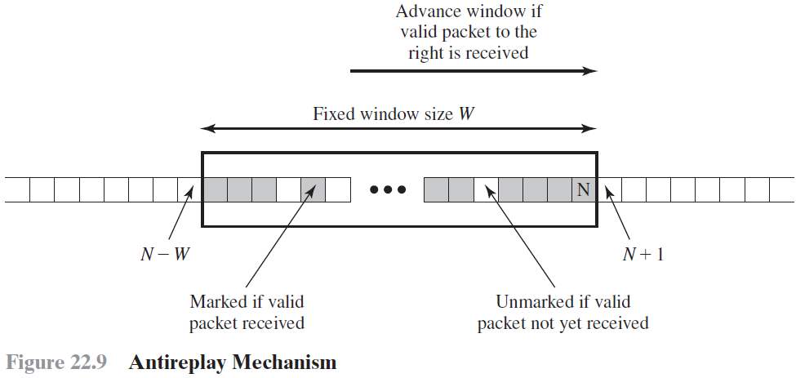
Anti-Replay w. Sliding Window
When a packet arrives with sequence number N and has been authenticated to be valid:
if N is smaller than the smallest number of the window, it is rejected.
If N is greater than the largest sequence number of the sliding window, the packet is accepted and the window advances to just cover N.
If N falls in the window, check to see if N has been received before:
If yes, it is rejected since it is a duplicate.
If not, it is accepted and N is marked as having been received.

Slide 28
IPSec Quiz
Which are true:
A. Security Association, SA, specifies a two-way security arrangements between the sender and receiver.
B. SPI is used to help receiver identify the SA to un-process the IPSec packet.
C. If the sequence number in the IPSec header is greater than the largest number of the current anti-replay window the packet is rejected.
D. If the sequence number in the IPSec header is smaller than the smallest number of the current anti-replay window the packet is rejected.
ANS: B, D
A. SA is “One-way relationship between a sender and a receiver, defined by IPSec parameters. One SA for inbound traffic, another SA for outbound.”
C. “the packet is accepted and the window advances to just cover N.”
Notes:
QUIZ:
Discuss
---
SOLUTION:
1. F. 2. T. 3. F 4. T.

Slide 29
Outline
IPSec
Tunnel mode, transport mode
ESP and AH for confidentiality and authenticity
Transport Layer Security (TLS)
Record protocol
Handshake protocol
Notes:
IPSec can operate in tunnel or transport mode
Confidentiality and authenticity protection provided through ESP and AH
The one-way security association stores security parameters.
SSL/TLS has two layers:
record protocol
handshake, change cipher spec and alert protocols

Slide 30
SSL and TLS
Secure Socket Layer (SSL) is a general-purpose service implemented as a set of protocols that rely on TCP.
Transport Layer Security (TLS) is an updated, more secure, version of SSL, and an Internet standard.
Two implementation choices.
TLS could be provided as part of the underlying protocol suite and therefore be transparent to applications.
Alternatively, TLS can be embedded in specific packages.
Notes:
One of the most widely used security services is the Secure Sockets Layer (SSL) and the follow-on Internet standard known as Transport Layer Security (TLS). TLS has largely supplanted earlier SSL implementations. TLS is a general-purpose service implemented as a set of protocols that rely on TCP. At this level, there are two implementation choices. For full generality, TLS could be provided as part of the underlying protocol suite and therefore be transparent to applications. Alternatively, TLS can be embedded in specific packages.
For example, most browsers come equipped with SSL, and most Web servers have
implemented the protocol.

Slide 31
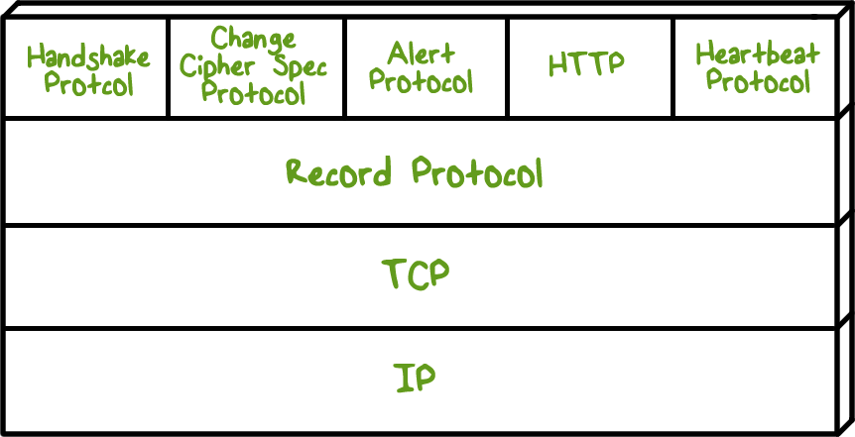
TLS Layers
TLS has two layers
Record Protocol provides basic security services to higher-layer protocols, e.g. HTTPS.
Three higher-layer protocols used in the management of TLS exchanges.
Handshake Protocol, Change Cipher Spec Protocol, Alert Protocol.
Notes:
TLS is designed to make use of TCP to provide a reliable end-to-end secure service.
TLS is not a single protocol but rather two layers of protocols, as illustrated in this Figure.
The Record Protocol provides basic security services to various higher-layer
protocols. In particular, the Hypertext Transfer Protocol (HTTP), which provides
the transfer service for Web client/server interaction, can operate on top of TLS.
Three higher-layer protocols are defined as part of TLS: the Handshake Protocol,
the Change Cipher Spec Protocol, and the Alert Protocol. These TLS-specific protocols
are used in the management of TLS exchanges.

Slide 32
TLS Concepts
TLS Session
An association between a client and a server
Created by the Handshake Protocol
Defines a set of cryptographic security parameters
Used to avoid the expensive negotiation of new security parameters for each connection
TLS Connection
A transport-layer connection that provides a suitable type of service
Peer-to-peer relationships
Transient
Every connection is associated with one session
Notes:
Two important TLS concepts are the TLS session and the TLS connection,
which are defined in the specification as follows:
• Connection : A connection is a transport (in the OSI layering model definition)
that provides a suitable type of service. For TLS, such connections are peer-to-
peer relationships. The connections are transient. Every connection is
associated with one session.
• Session : A TLS session is an association between a client and a server. Sessions
are created by the Handshake Protocol. Sessions define a set of cryptographic
security parameters, which can be shared among multiple connections.
Sessions are used to avoid the expensive negotiation of new security
parameters for each connection.
Between any pair of parties (applications such as HTTP on client and
server), there may be multiple secure connections. In theory, there may also be
multiple simultaneous sessions between parties, but this feature is not used in
practice.

Slide 33
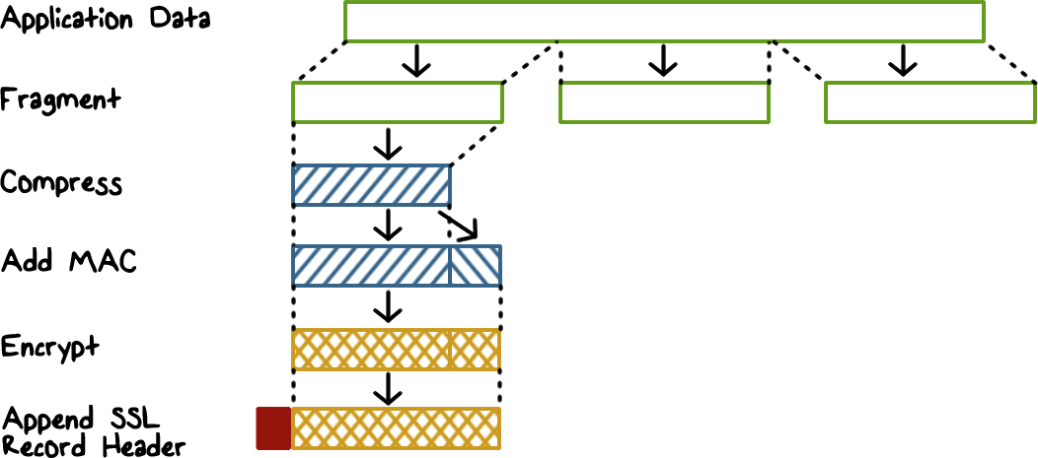
SSL Record Protocol
The content types that have been defined are change_cipher_spec, alert, handshake, and application_data.
Record Protocol steps:
1. Fragmentation, where each upper-layer message is fragmented into blocks.
2. Compression (optional).
3. Compute a MAC over the compressed data.
4. Encrypt the compressed message plus MAC using symmetric encryption.
5. Prepend an SSL record header, which includes version and length fields.
6. Transmit the resulting unit in a TCP segment.
At the receiver side. received data are decrypted, verified, decompressed, and reassembled, and then delivered to higher-level users.
Notes:
This figure shows the overall operation of the SSL Record Protocol. The
first step is fragmentation . Each upper-layer message is fragmented into blocks. Next, compression is optionally applied. The next
step in processing is to compute a message authentication code over the compressed
data. Next, the compressed message plus the MAC are encrypted using symmetric
encryption.
The final step of SSL Record Protocol processing is to prepend a header,
which includes version and length fields.
The content types that have been defined are change_cipher_spec, alert,
handshake, and application_data. The first three are the SSL-specific protocols,
discussed next. Note that no distinction is made among the various applications
(e.g., HTTP) that might use SSL; the content of the data created by such applications
is opaque to SSL.
The Record Protocol then transmits the resulting unit in a TCP segment.
Received data are decrypted, verified, decompressed, and reassembled, and then
delivered to higher-level users.

Slide 34
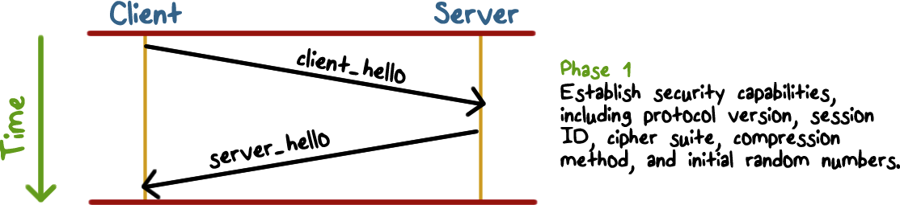
Handshake Protocol Phase 1
Handshake Protocol provides two services for SSL connections:
Confidentiality: define a shared secret key that is used for symmetric encryption of SSL payloads.
Integrity: define a shared secret key that is used to form MAC.
It consists of a series of messages exchanged between client and server, with four phases.
Phase 1 is used to initiate a logical connection and to establish the security capabilities that will be associated with it. The exchange is initiated by the client, which sends a client_hello message with the following parameters:
Notes:
The Handshake Protocol consists of a series of messages exchanged by client
and server.
This figure shows the initial exchange needed to establish a logical
connection between client and server. The exchange can be viewed as having
four phases.
Phase 1 is used to initiate a logical connection and to establish the security
capabilities that will be associated with it. The exchange is initiated by the client,
which sends a client_hello message with the following parameters:

Slide 35
Handshake Protocol Parameters
Version: the highest TLS version understood by the client
Random: a 32-bit timestamp and 28 bytes generated by a secure random number generator
Session ID: a variable-length session identifier
CipherSuite: a list containing the combinations of cryptographic algorithms supported by the client
Compression Method: a list of compression methods supported by the client
Notes:
• Version: The highest TLS version understood by the client.
• Random: A client-generated random structure, consisting of a 32-bit timestamp
and 28 bytes generated by a secure random number generator. These
values are used during key exchange to prevent replay attacks.
• Session ID: A variable-length session identifier. A nonzero value indicates
that the client wishes to update the parameters of an existing connection or
create a new connection on this session. A zero value indicates that the client
wishes to establish a new connection on a new session.
• CipherSuite: This is a list that contains the combinations of cryptographic
algorithms supported by the client, in decreasing order of preference. Each
element of the list (each cipher suite) defines both a key exchange algorithm
and a CipherSpec.
• Compression method: This is a list of the compression methods the client
supports.
After sending the client_hello message, the client waits for the server_hello
message, which contains the same parameters as the client_hello message.

Slide 36
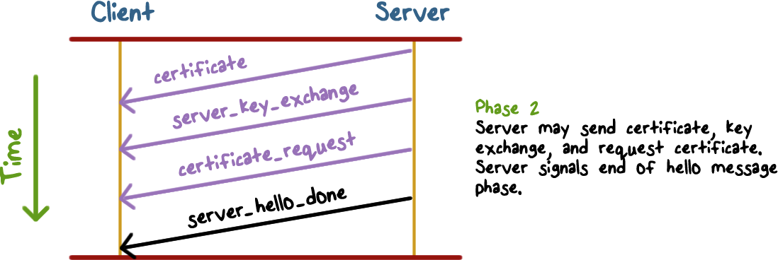
The Handshake Protocol Phase 2
The details of phase 2 depend on the underlying public-key encryption scheme. In some cases, the server passes a certificate to the client, possibly additional key information, and a request for a certificate from the client.
The final message in phase 2 is the server_done message, sent by the server to indicate the end of the server hello and associated messages. After sending this message, the server will wait for a client response.

Slide 37
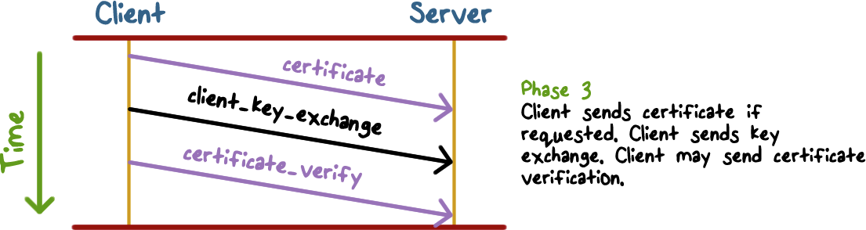
The Handshake Protocol Phase 3
In phase 3, upon receipt of the server_done message, the client should verify that the server provided a valid certificate (e.g., ZJU’s certificate), and check that the server_hello parameters are acceptable.
If all is satisfactory, the client sends one or more messages back to the server, depending on the underlying public-key scheme.

Slide 38
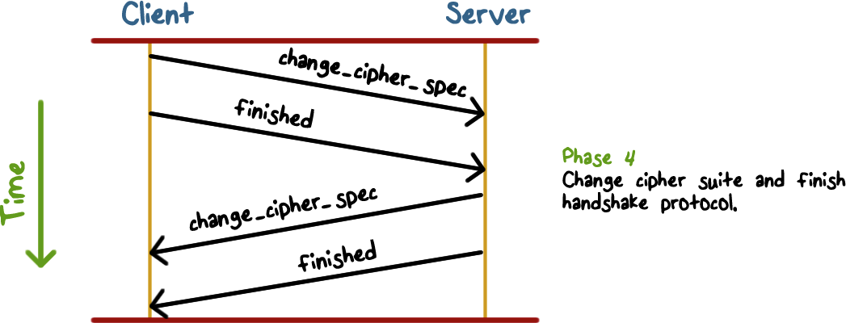
The Handshake Protocol Phase 4
Phase 4 completes the setting up of a secure connection. The client sends a change_cipher_spec message and copies the pending CipherSpec into the current CipherSpec. The client then immediately sends the finished message under the new algorithms, keys, and secrets. The finished message verifies that the key exchange and authentication processes were successful.
In response to these two messages, the server sends its own change_cipher_spec message, transfers the pending to the current CipherSpec, and sends its finished message.
At this point, the handshake is complete. The client and server now agree on the security parameters, so they may begin to exchange application data.
Notes:
Note that this message is not considered part of the Handshake Protocol
but is sent using the Change Cipher Spec Protocol.

Slide 39
Key Exchange Protocol in one slide.

Slide 40
SSL & TLS Quiz
A. Most browsers come equipped with SSL or TLS and most Web servers have implemented the protocol.
B. Since TLS is for the transport layer, it relies on IPsec which is for the IP layer.
C. In most applications of TLS or SSL, public keys are used for authentication and key exchange.
ANS: A, C.
B is false. TLS does not rely on IPSec.

Slide 41
Summary
IPSec can operate in tunnel or transport mode
Confidentiality and authenticity protection provided through ESP and AH
The one-way security association stores security parameters.
SSL/TLS has two layers:
record protocol
handshake, change cipher spec and alert protocols

